Slide 1
Process Synchronization Lesson 1 Introduction
David Liu
Fall 2021, Spring 2022

Slide 2
Process Execution and Shared Data
Process Execution
Order in time
Shared Data
consistency

Slide 3
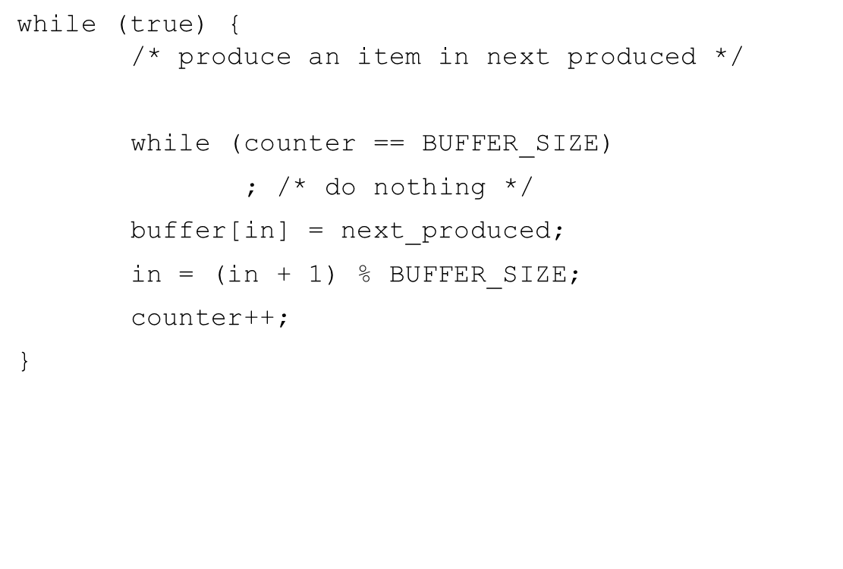
Two Processes
Producer
Consumer
while (true) {
while (counter == 0)
; /* do nothing */
next_consumed = buffer[out];
out = (out + 1) % BUFFER_SIZE;
counter--;
/* consume the item in next consumed */
}

Slide 4
Two Processes and One Shared Data
counter++ could be implemented as register1 = counter register1 = register1 + 1 counter = register1
counter-- could be implemented as register2 = counter register2 = register2 - 1 counter = register2
Consider this execution interleaving with “count = 5” initially:
S0: producer execute register1 = counter {register1 = 5} S1: producer execute register1 = register1 + 1 {register1 = 6} S2: consumer execute register2 = counter {register2 = 5} S3: consumer execute register2 = register2 – 1 {register2 = 4} S4: producer execute counter = register1 {counter = 6 } S5: consumer execute counter = register2 {counter = 4}

Slide 5
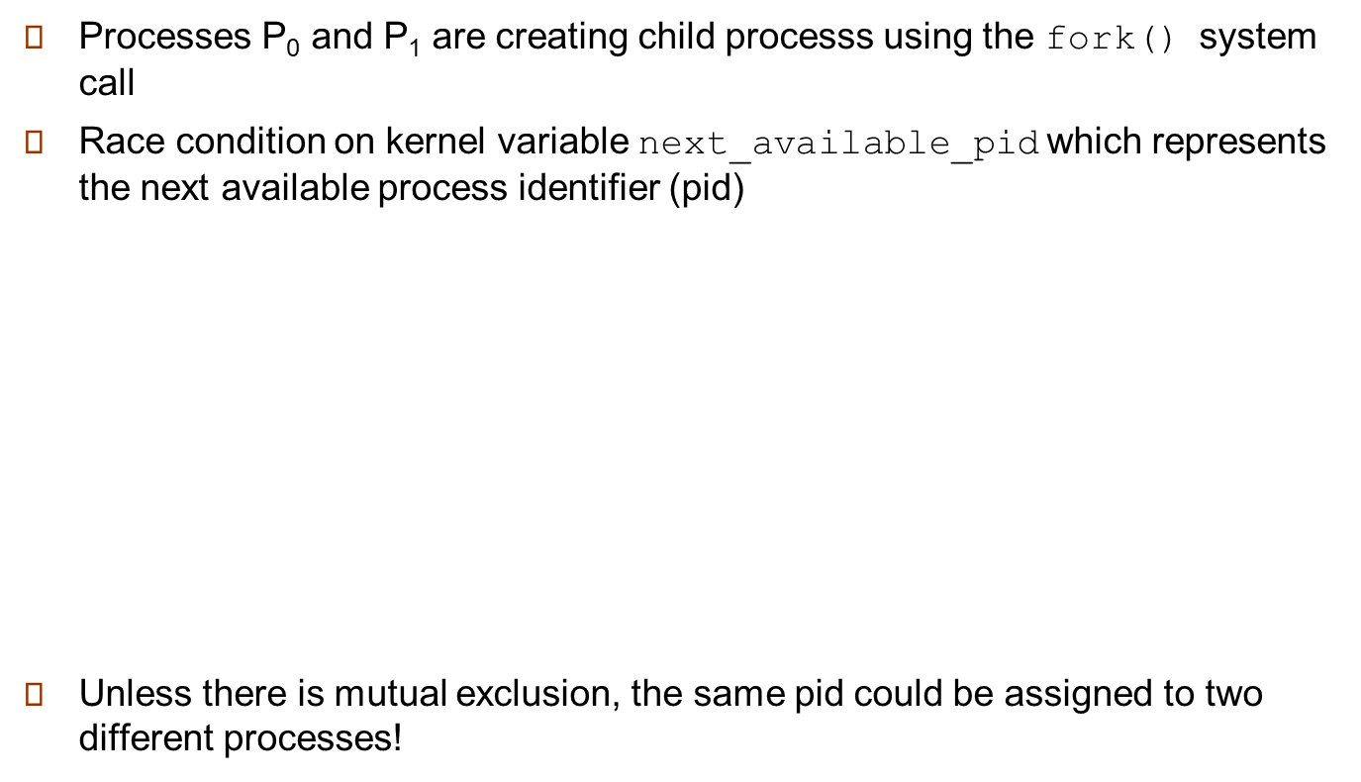

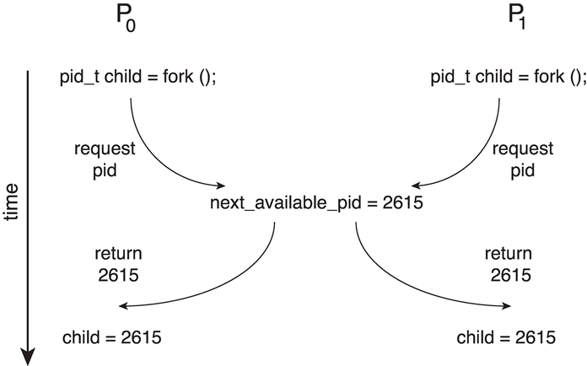
Race Condition
Several processes access and manipulate the same data concurrently and the outcome of the execution depends on the particular order in which the access takes place

